Slide 1

Automated word prediction in telugu language using
Statistical approach
Date: 27 May 2021
Gajula Kirthana - 17wh1a0514
Kunamsetti Vaishnavi - 17wh1a0548
Saka Devi Sree- 18wh5a0508
Internal Guide: Dr.L. lakshmi
Designation: Professor
Department of Computer Science & Engineering
BVRIT HYDERABAD College of Engineering for Women

Slide 2
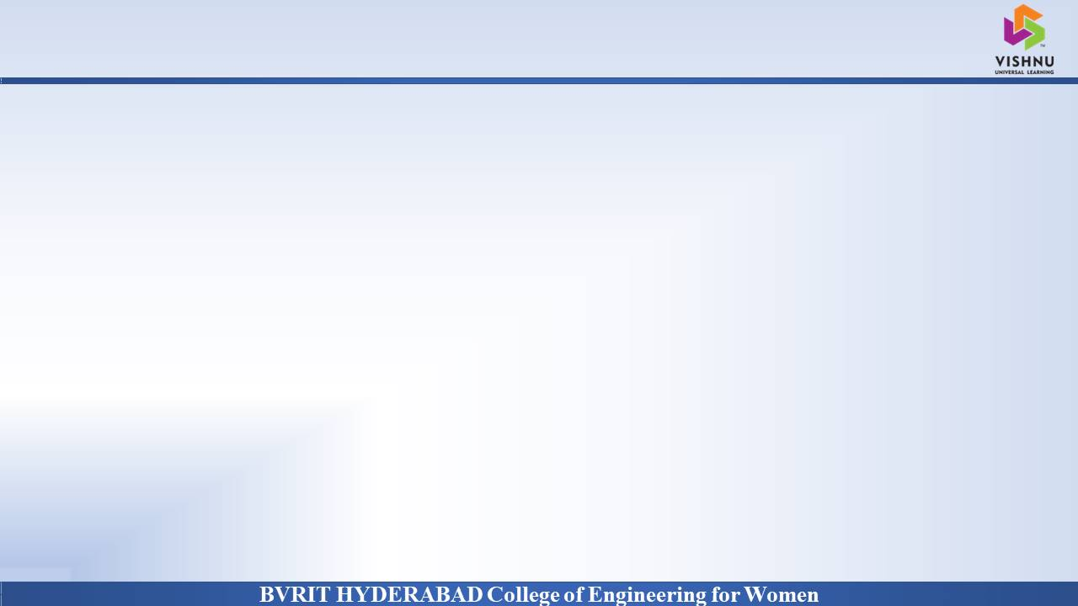
Why Should I Study this course?
ABSTRACT
Examples
Word prediction is one of the important phenomena in typing that benefit various types of users who use a keyboard to write. This can be an onscreen keyboard on a smartphone or digital tablet. It can be a physical keyboard connected to a device or computer. They can have a profound impact on the typing of disable people. It is based on word prediction on Telugu sentence by using statistical approach, i.e. N-gram language models such as unigram, bigram, trigram, Language Models helps in predicting the next few words in sequence from the past history, for predicting the next word using probabilities which saves time and keystrokes of typing and also reduces misspelling. We use a large data corpus of Telugu language of different word types to predict the correct word with the accuracy as much as possible.
BVRIT HYDERABAD College of Engineering for Women

Slide 3
Why Should I Study this course?
INTRODUCTION
Problem Statement:
Given a previous n-word sequence of Telugu language, predict next Telugu word. The statistical language modelling is done based on the probabilities and statistical approaches.It accepts previous n Telugu words as input and predict best fit next Telugu word.
Input : Previous ‘n’ Telugu word sequence
Output : Next Telugu word
.
Examples
BVRIT HYDERABAD College of Engineering for Women

Slide 4
Why Should I Study this course?
DATASET
The dataset is collected from Telugu wikipedia page.
Total 5 lakhs wiki documents are extracted Data.
It is a collection of different domains like districts, Poems, Poets, History etc.
From extracted wiki documents data, 5,00,000 clean sentences (which mostly has Telugu words) are taken for model development and testing.
Total Number of words and unique words: 3,43,917 & 1,52,934
Train Data: 4,50,000, Test data: 50,000 sentences
https://docs.google.com/document/d/1SFqKH3ydlDMwTvaGVOzo0IjtNNZ3l6kp-wq6n-if8kA/edit
Examples
BVRIT HYDERABAD College of Engineering for Women

Slide 5
Architecture
Data Collection
Examples
Data preprocessing
Language modelling
Probabilities
Data Interpretation
BVRIT HYDERABAD College of Engineering for Women

Slide 6
Why Should I Study this course?
TECHNOLOGY STACK
Supervised Machine Learning
Python Language
Required Packages
●CLTK
Examples
BVRIT HYDERABAD College of Engineering for Women

Slide 7
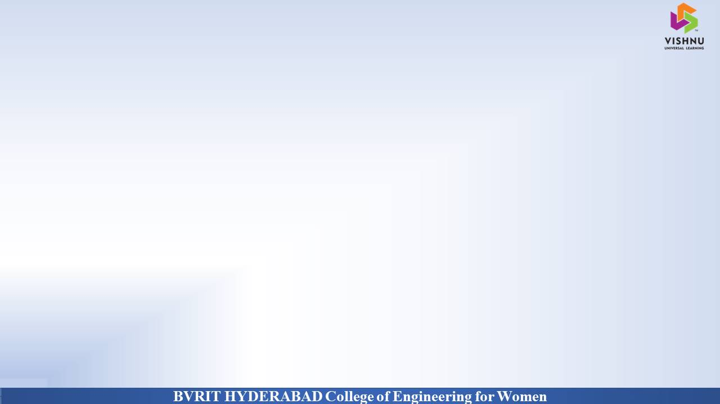
SYSTEM SPECIFICATIONS
ENVIRONMENT | SPECIFICATIONS
HARDWARE | Processor - Any Intel Processor Memory(RAM) - 8 GB and more Speed - 1GHZ and more
SOFTWARE | OS - Windows 10 Google Colab Anakonda-Jupyter notebook
Use this slide for flow of content.
BVRIT HYDERABAD College of Engineering for Women
BVRIT HYDERABAD College of Engineering for Women

Slide 8
Why Should I Study this course?
Data Pre-Processing
Examples
• Tokenization: It is a process of breaking paragraphs into sentences which in turn breaks into words called as tokens. We used CLTK Sentence tokenizer to tokenize the text.
• Cleaning : The raw data contains many unnecessary strings like html tags, english words, punctuations etc. We removed all such unnecessary string.
BVRIT HYDERABAD College of Engineering for Women

Slide 9
Why Should I Study this course?
Model Dictionary Creation
Examples
Language Modelling:
• Language Modelling is used to build a language model that provides context to distinguish between words and phrases that sound similar.
• A statistical language model provide likelihood of different string P(s) over given strings S.
• Language Model basically predicts the next word in a given sequence by assigning a probability to a sequence of words.
P(wn)=P(wn|w1,w2,w3,w4,w5,...,wn−1)
BVRIT HYDERABAD College of Engineering for Women

Slide 10
Why Should I Study this course?
Model Dictionary Creation
Markov Assumption:
The Markov assumption states that only a limited number of previous words affect the probability of the next word.
● It makes predictions for the future of the process based solely on its present state. P(wn|w1,w2,w3,w4,w5,...,wn−1)=P(wn|wn−1)
Examples
BVRIT HYDERABAD College of Engineering for Women

Slide 11

Why Should I Study this course?
Smoothing
Examples
• Smoothing techniques are used to address scenarios related to determining probability / likelihood estimate of a sequence of words occurring together when one or more words individually (unigram) or N-grams such as bigram or trigram in the given set have never occurred in the past.
• Add-one (or) Laplace Smoothing:
In Laplace smoothing, one is added to all the counts and thereafter, the probability is calculated.
BVRIT HYDERABAD College of Engineering for Women

Slide 12
Why Should I Study this course?
Evaluation metric
Examples
• It is an evaluation metric for N-gram models.
• Perplexity is the inverse probability of the test set normalized by the number of words.
• Perplexity is a simple transformation of cross-entropy
BVRIT HYDERABAD College of Engineering for Women

Slide 13
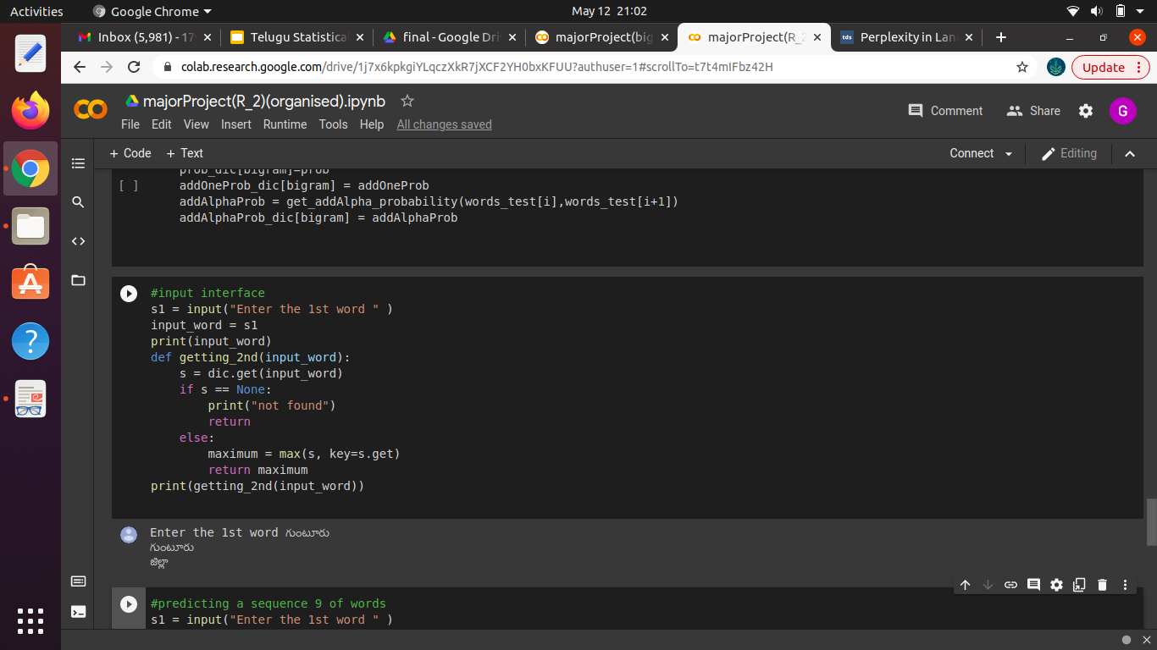
Why Should I Study this course?
Sample Output
Examples
BVRIT HYDERABAD College of Engineering for Women

Slide 14
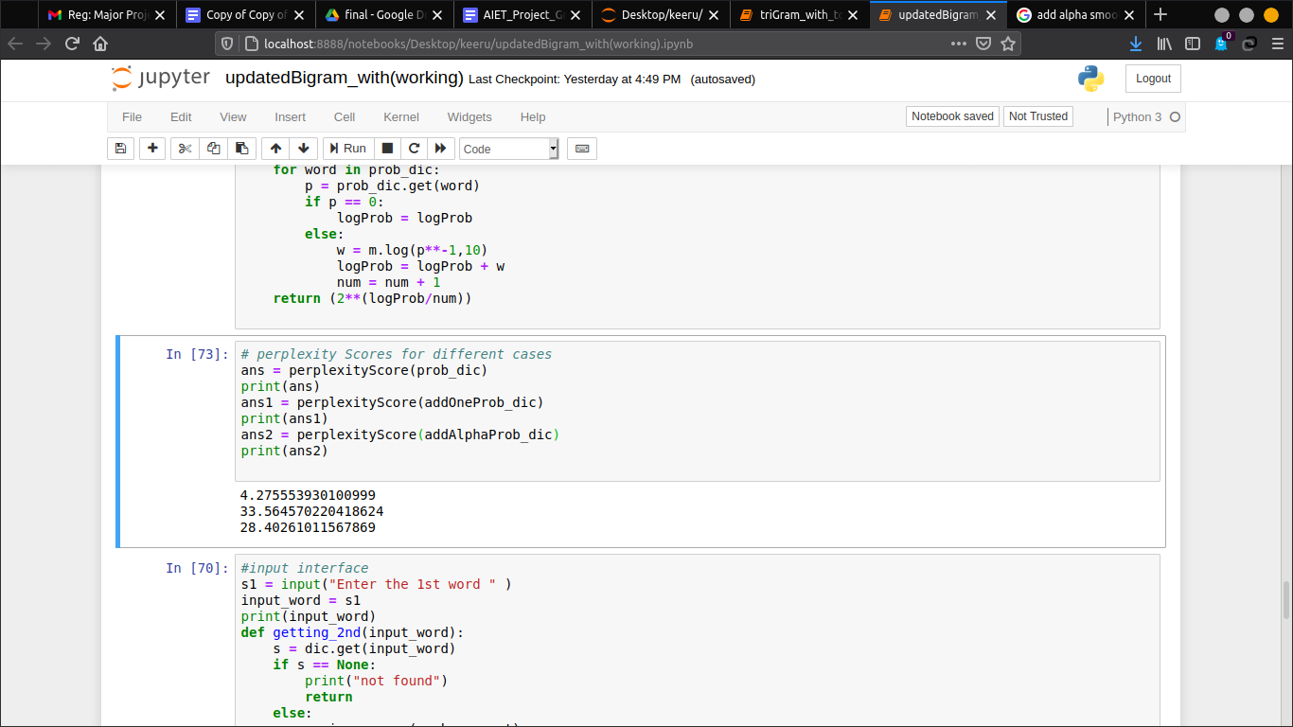
Why Should I Study this course?
Perplexity scores
Examples
BVRIT HYDERABAD College of Engineering for Women

Slide 15
Why Should I Study this course?
TIMELINE
Review 0 | Requirements and Specifications
Review 1 | Dataset Collection Data Set Preprocessing
Review 2 | Model Dictionary Creation Evaluation Metric Smoothing
Review 3 | Interpretation of Results Report of the Project
Examples
BVRIT HYDERABAD College of Engineering for Women

Slide 16
REFERENCES
Base paper :
https://drive.google.com/drive/u/0/folders/1Wcs4STEdfdOYsTQCoVc65_G-ogsfQFv5
Reference papers :
https://www.cs.cmu.edu/~roni/papers/SLM-TK-V2-eurospeech-97.pdf
https://anoopkunchukuttan.github.io/indic_nlp_library/
BVRIT HYDERABAD College of Engineering for Women

Slide 17
Thankyou
BVRIT HYDERABAD College of Engineering for Women

